Slide 1
Essential Question:
How did the American desire for Manifest Destiny lead to the acquisition of Texas, Oregon, & California?
CPUSH Agenda for Unit 5.2:
Manifest Destiny notes

Slide 2
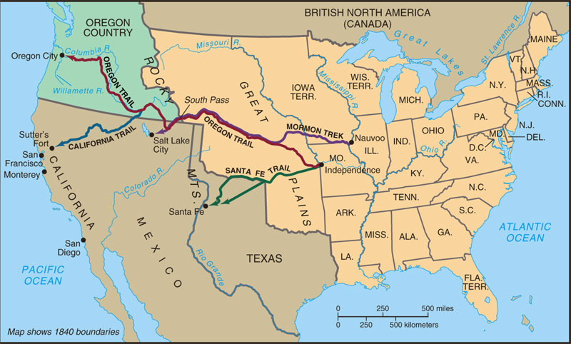
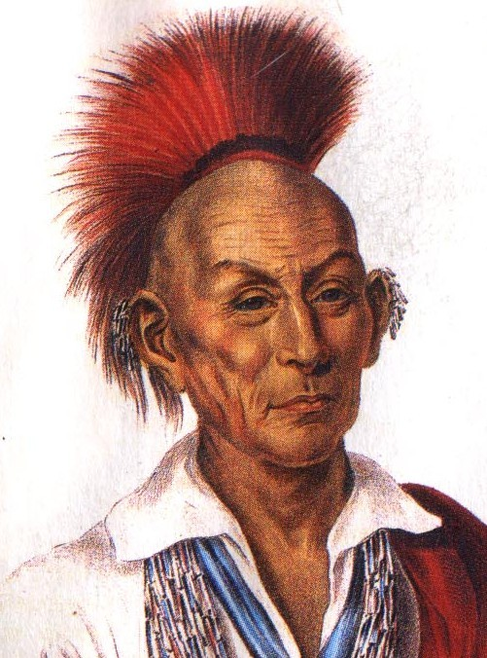
Westward expansion brought conflict with Indians, such as the Black Hawk War, as trails disrupted hunting grounds and violated previous treaties

Slide 3
The Treaty of Fort Laramie created a vast Indian Territory but was repeatedly ignored by whites expanding West

Slide 4
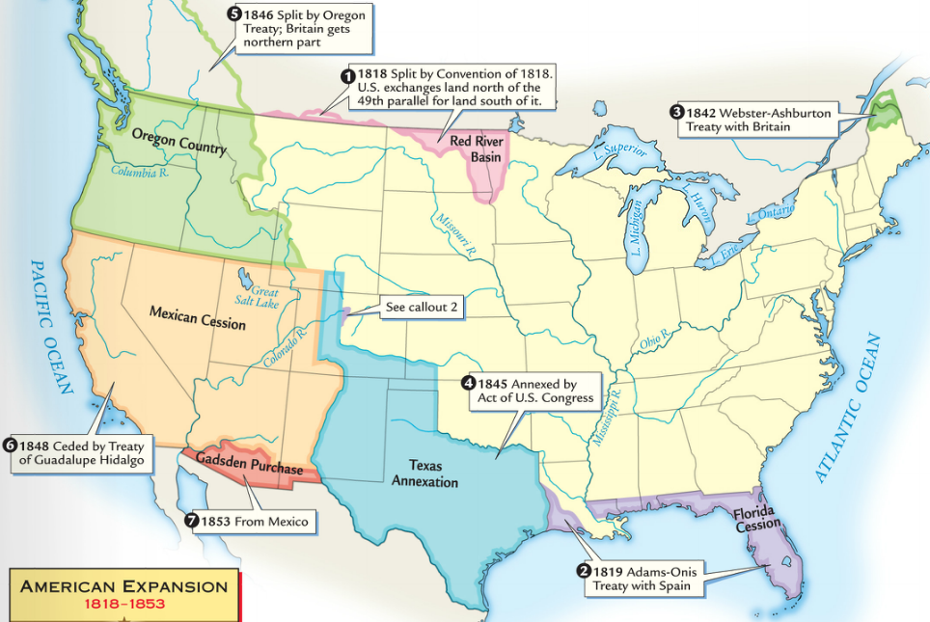
In the 1840s, America realized its “manifest destiny” by acquiring all lands to the Pacific Ocean
In 1845, the USA annexed the independent nation of Texas
In 1846, the U.S. settled a dispute with England to gain Oregon
In 1848, the USA gained new lands in the SW by winning the Mexican- American War

Slide 5
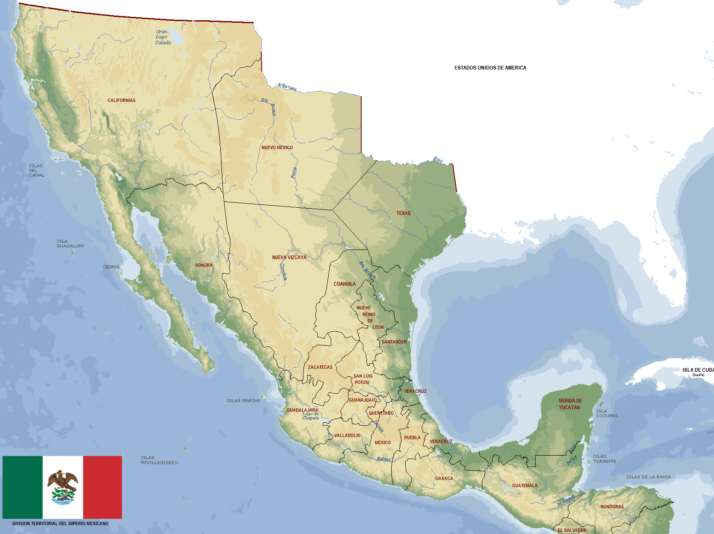
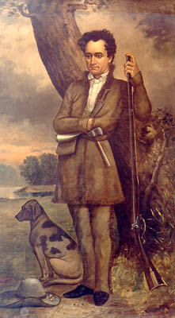
Texas
In 1821, Mexico won independence from Spain and the new Mexican gov’t welcomed Americans into Texas by offering cheap land
Stephen F Austin became one of the wealthiest “Anglos” in Texas

Slide 6
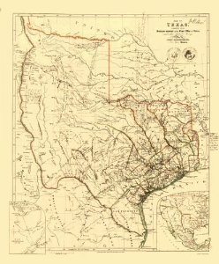
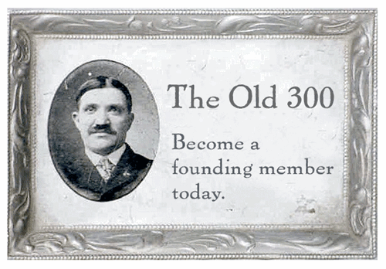
Texas
Austin established a community where “no drunkard, no gambler, no profane swearer and no idler” would be allowed

Slide 7
The Mexican government encouraged settlement to protect the borders from Native Americans
Texas
Mexico offered land grants to agents (empresarios) to sell to settlers
They settlers would pledge to obey Mexican laws and observe Roman Catholicism

Slide 8
Americans refused to accept Mexican laws
They would not convert to Catholicism
They would not accept a ban on slavery
They wanted a voice in Mexican government

Slide 9
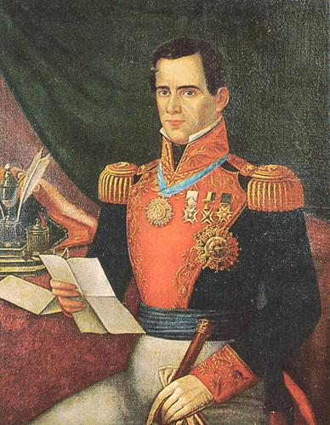
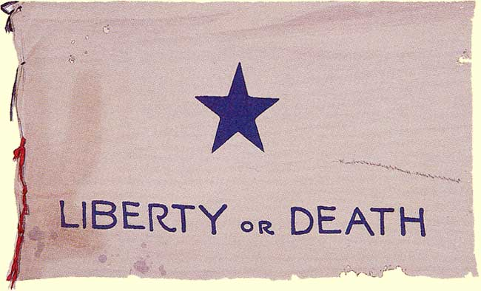
By 1834, Mexican president Santa Anna began to view Anglos as a threat and had Austin arrested
In 1835, Texans were in open rebellion against the Mexican government

Slide 10
In 1835, the War for Texas Independence began
Texans lost at the Alamo, but the battle created inspiration: “Remember the Alamo!”

Slide 11
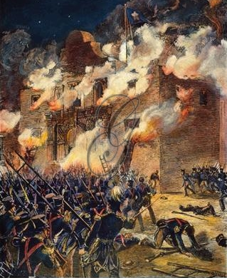
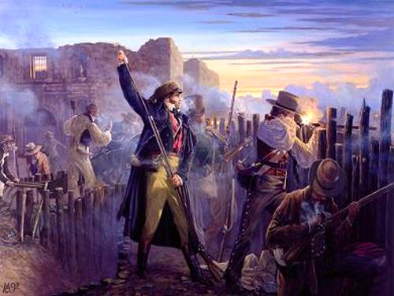
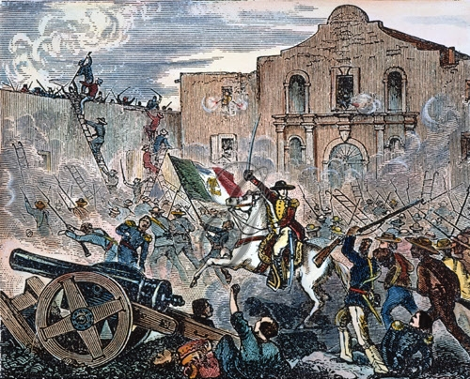
Jim Bowie
Davy Crockett

